Slide 1
Common Architectures
Instructor:

Slide 2
Agenda
What is Software Architecture?
Client-Server Architecture
3-Tier / Multi-Tier Architectures
MVC (Model-View-Controller)

Slide 3
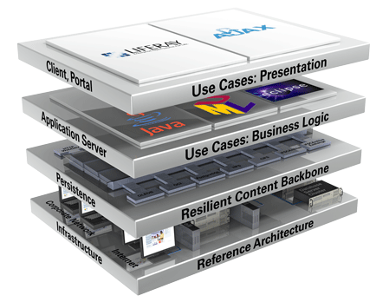
What is Software Architecture?

Slide 4

Software Architecture
Software architecture is a technical blueprint explaining how the system will be structured
The system architecture describes:
How the system will be decomposed into subsystems (modules)
Responsibilities of each module
Interaction between the modules
Platforms and technologies
Each module could also implement a certain architectural model / pattern

Slide 5
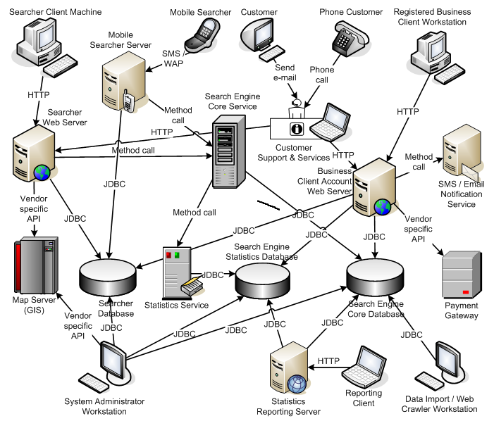
System Architecture Diagram – Example

Slide 6
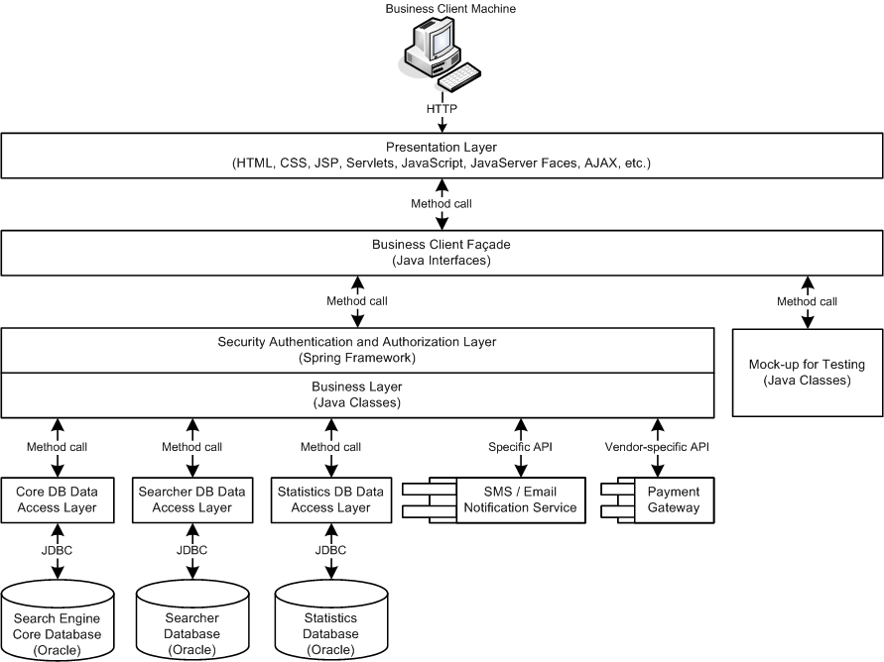
Example of Multi-Tier Software Architecture

Slide 7
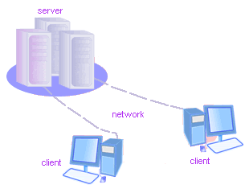
Client-Server Architecture
The Classical Client-Server Model

Slide 8
Client-Server Architecture
The client-server model consists of:
Server – a single machine / application that provides services to multiple clients
Could be IIS based Web server
Could be WCF based service
Could be a services in the cloud
Clients –software applications that provide UI (front-end) to access the services at the server
Could be WPF, HTML5, Silverlight, ASP.NET, …

Slide 9
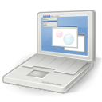
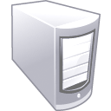


The Client-Server Model
Client
Machine
network connection
network connection
Mobile
Client
network connection
Server
Desktop
Client

Slide 10
Client-Server Model – Examples
Web server (IIS) – Web browser (Firefox)
FTP server (ftpd) – FTP client (FileZilla)
EMail server (qmail) – email client (Outlook)
SQL Server – SQL Server Management Studio
BitTorrent Tracker – Torrent client (μTorrent)
DNS server (bind) – DNS client (resolver)
DHCP server (wireless router firmware) – DHCP client (mobile phone /Android DHCP client/)
SMB server (Windows) – SMB client (Windows)

Slide 11
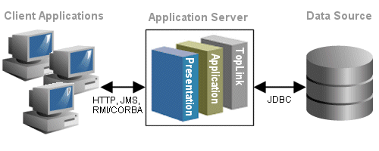
3-Tier / Multi-Tier Architectures
Classical Layered Structure of Software Systems

Slide 12
The 3-Tier Architecture
The 3-tier architecture consists of the following tiers (layers):
Front-end (client layer)
Client software – provides the UI of the system
Middle tier (business layer)
Server software – provides the core system logic
Implements the business processes / services
Back-end (data layer)
Manages the data of the system (database / cloud)

Slide 13

The 3-Tier Architecture Model
Data Tier
(Back-End)
Middle Tier
(Business Tier)
Client Tier (Front-End)
Client
Machine
network
network
Mobile
Client
network
Database
Business
Logic
Desktop
Client

Slide 14

Typical Layers of the Middle Tier
The middle tier usually has parts related to the front-end, business logic and back-end:
Presentation Logic
Implements the UI of the application (HTML5, Silverlight, WPF, …)
Business Logic
Implements the core processes / services of the application
Data Access Logic
Implements the data access functionality (usually ORM framework)

Slide 15
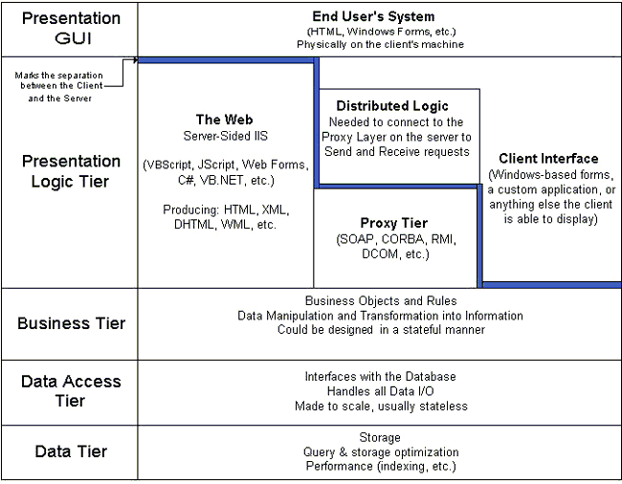
Multi-Tier Architecture
HTML
ASP
.NET
WCF
ORM
DB

Slide 16
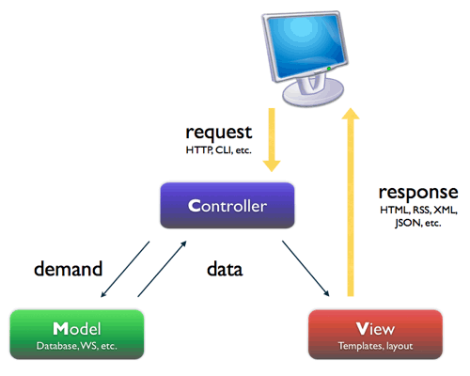
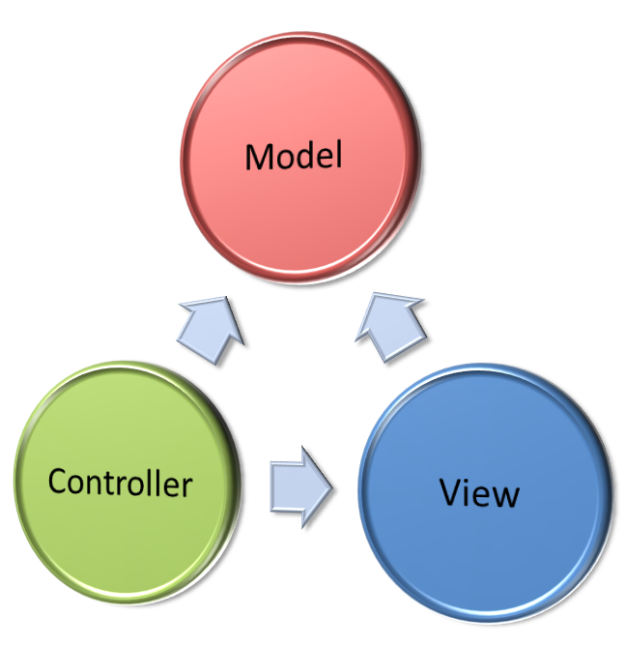
MVC (Model-View-Controller)
What is MVC and How It Works?

Slide 17
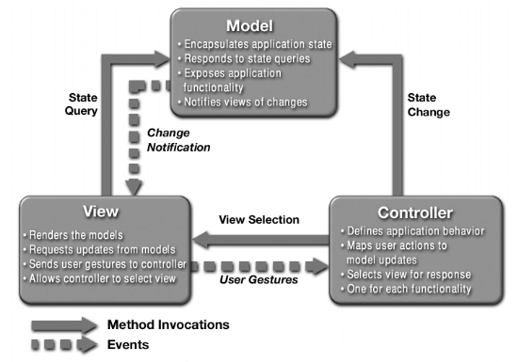
MVC Architecture Blueprint

Slide 18
Model-View-Controller (MVC)
Model-View-Controller (MVC) architecture
Separates the business logic from application data and presentation
Model
Keeps the application state (data)
View
Displays the data to the user (shows UI)
Controller
Handles the interaction with the user

Slide 19
MVC - Model
Models data and behavior behind business process
Manages Information - If Changes
Contains data and Related Functionality
Maps Real-World Entities
Performing DB Queries
Calculating Business Process
Encapsulates Domain Logic which are independent of Presentation

Slide 20
MVC - View
Obtains data from model & presents to the user
Represents Output/Input of the application
Display results of Business Logic
Free Access to Model
Reads Data from Model – Using Query Methods

Slide 21
MVC - Controller
Serves logical connection between user’s interaction and the business process
It receives and Translates input to request on model or view
Input from user and instructs the model and view to perform action
Responsible for making decision among multiple presentation
Maps the end-user action to the application response

Slide 22
Relationship between Components
View and Controller
Controller is responsible for creating or selecting view
Model and Controller
Controller depends on model
If a change is made to the model then there might be required to make parallel changes in the Controller
Model and View
View depends on Model
If a change is made to the model then there might be required to make parallel changes in the view

Slide 23
MVC – Based Frameworks
.NET
ASP.NET MVC, MonoRail
Java
JavaServer Faces (JSF), Struts, Spring Web MVC, Tapestry, JBoss Seam, Swing
PHP
CakePHP, Symfony, Zend, Joomla, Yii, Mojavi
Python
Django, Zope Application Server, TurboGears
Ruby on Rails

Slide 24
MVC & Multi-Tier Architecture
MVC does not replace the multi-tier architecture
Both are usually used together
Typical multi-tier architecture can use MVC
To separate logic, data and presentation
Controllers (Input / Output Control Logic)
Views (Presentation)
Model
(Data Modeling, Business Logic, Data Access Logic)

Slide 25


